Slide 1
STACK DATA STRUCTURE
Name:v.chathurya
Roll no: 25p61A05AH
Branch: cse-F

Slide 2
Introduction to Stack
A stack is a linear data structure that follows a specific order for operations.
The order is called LIFO (Last In, First Out).
This means that the element inserted last is the one that will be removed first.

Slide 3
BASIC CONCEPTS OF STACK
LIFO Principle
The stack follows the Last In, First Out principle:
The last element added is the first to be removed.
Similar to a stack of plates.
Terminology
Push: Adding an element to the stack
Pop: Removing an element from the stack
Peek/Top: Viewing the top element
Overflow: When stack is full
Underflow: When stack is empty

Slide 4
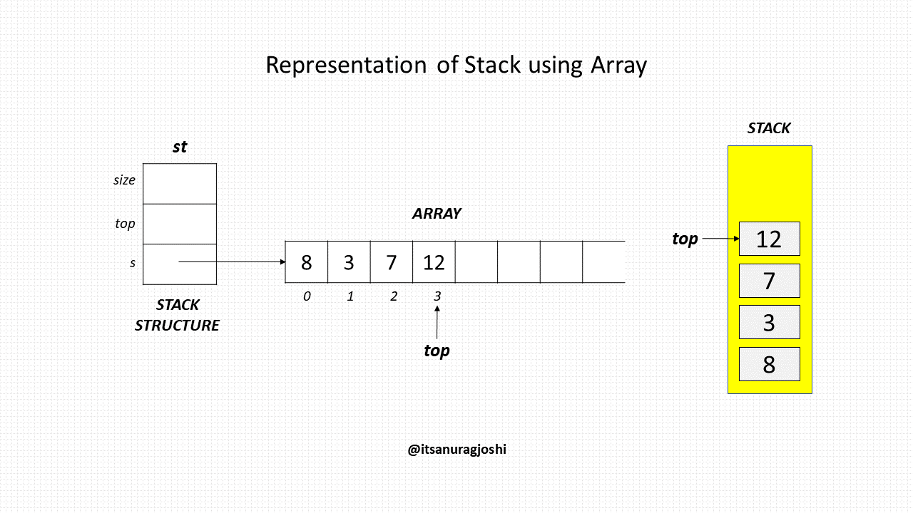
REPRESENTATION OF STACK
Stacks can be implemented in two ways:
Stack using Arrays
Uses a fixed-size array
Requires a variable called top
to track the position
Example:
Stack: [10, 20, 30] Top → 30

Slide 5
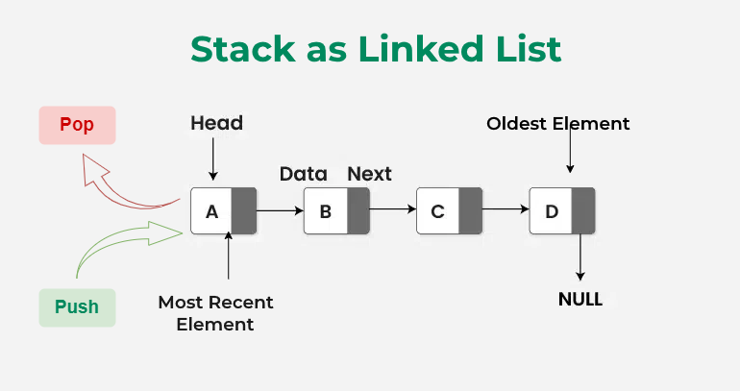
Stack using linked list
Uses dynamic memory allocation
No fixed size limitation
Advantages:
Efficient memory usage
No overflow (until memory is full)

Slide 6
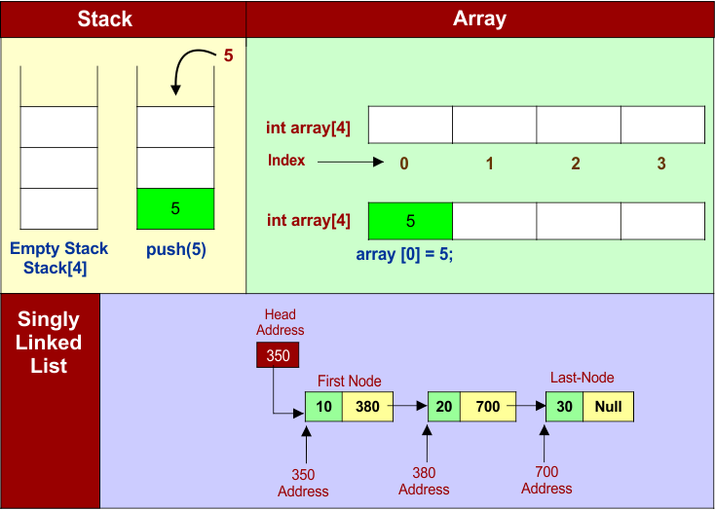
STACK OPERATIONS
Push Operation
Adds an element to the top of the stack.
Algorithm:
Check if stack is full
If full → Overflow
Else increment top
Insert element at top

Slide 7
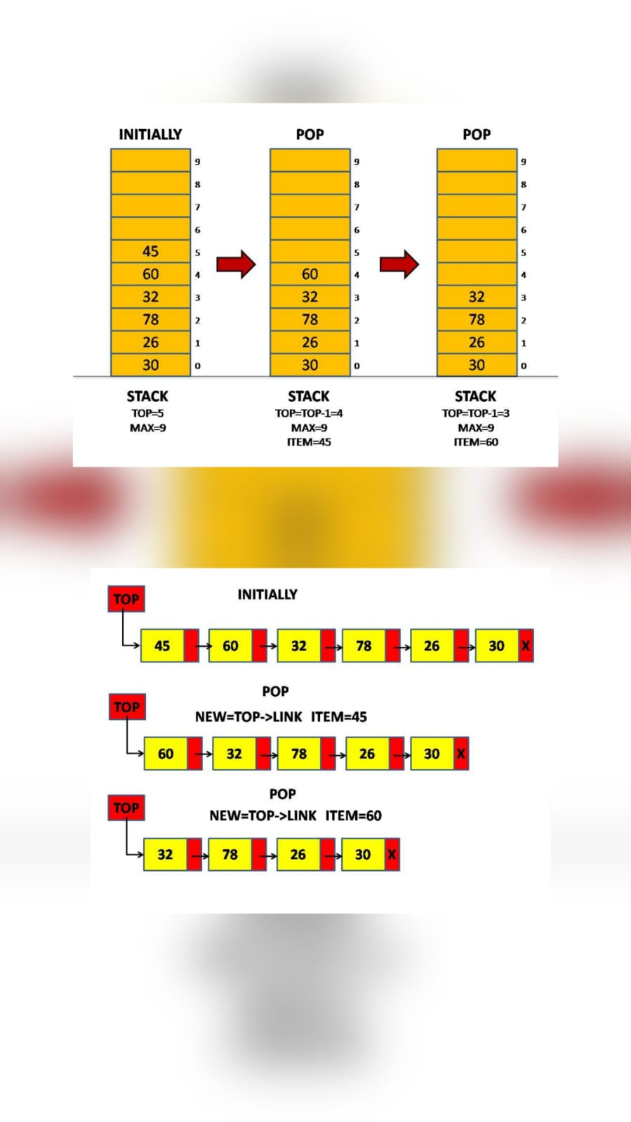
Pop Operation
Removes the top element from the stack.
Algorithm:
Check if stack is empty
If empty → Underflow
Else remove element
Decrement top

Slide 8
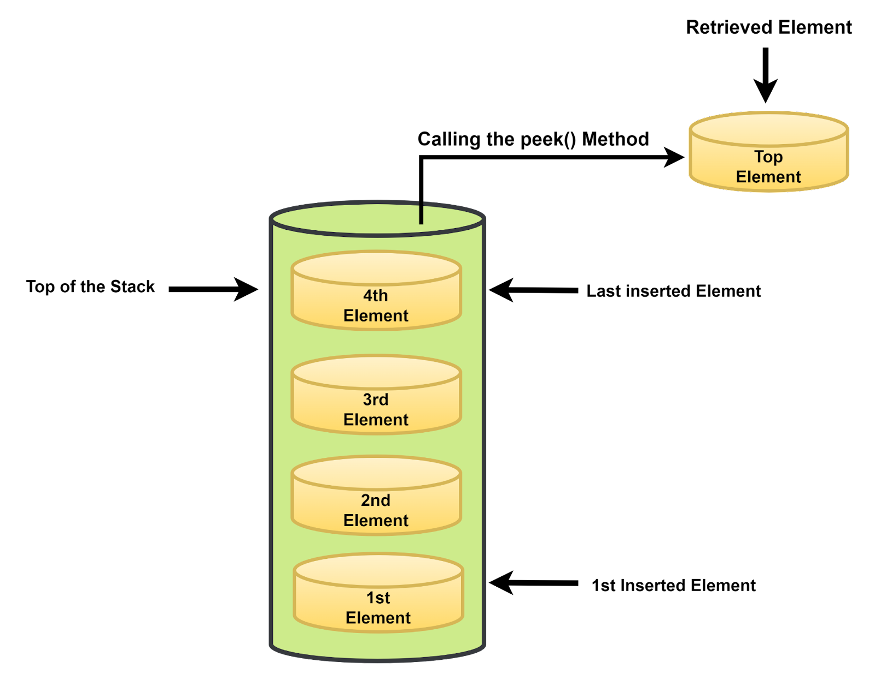
Peek Operation
Returns the top element without removing it.
Algorithm:
Check if stack is empty
Return element at top
Display Operation
Prints all elements from top to bottom.

Slide 9
STACK ALGORITHM(Using Array)
Initialization
top = -1
Push Algorithm
IF top == MAX - 1
PRINT "Stack Overflow"
ELSE
top = top + 1
stack[top] = value
END

Slide 10
Pop Algorithm
IF top == -1
PRINT "Stack Underflow"
ELSE
value = stack[top]
top = top - 1
END
Peek Algorithm
IF top == -1
PRINT "Stack is Empty"
ELSE
PRINT stack[top]
END

Slide 11
STACK IMPLEMENTATION
#include <stdio.h>
#define MAX 5
int stack[MAX];
int top = -1;
void push(int value) {
if (top == MAX - 1) {
printf("Stack Overflow\n");
} else {
top++;
stack[top] = value;
}
}
void pop(){
if (top == -1) {
printf("Stack Underflow\n");
} else {
printf("Deleted: %d\n", stack[top]);
top--;
}
}
void peek() {
if (top == -1) {
printf("Stack is empty\n");
} else {
printf("Top element: %d\n", stack[top]);
}}
void display() {
int i;
if (top == -1) {
printf("Stack is empty\n");
} else {
for (i = top; i >= 0; i--) {
printf("%d\n", stack[i]);
} } }
int main() {
push(10);
push(20);
push(30);
display();
pop();
peek();
return 0;

Slide 12
Advantages of stack
Simple and easy to implement
Efficient for LIFO operations
Useful in recursion and memory management
Disadvantages of stack
Limited size(In array implementation)
Cannot access elements randomly
Only top element is accessible

Slide 13
THANK YOU

